Slide 1
Swing Cam
＆
Half Mount Cam
We Your Business Co.,Ltd. has been developing “Swing Cam System”as the third negative angle forming technology, and developed “Half Mount Cam System” since last year. According to these technology, it has achieved to reduce of forming process, saving a cost, improving quality of panel and maintenance by the continuous forming.
We have prepared this technical documents for your initial review of using Swing Cam & Half Mount Cam.
We hope you will find this useful documents.
(Regarding the standard components for Swing Cam & Half Mount Cam, we will separately apply the sheet.)
Your Business Co.,Ltd.
Ver. No.20210701YB

Slide 2
-Contents-
Automobile die technology PR material
New technology of die Swing Die＆Half Mount Cam -Contents-
⒈ Features of Swing Cam ………………………………………
1.1 Features of Swing Cam ① …………………………………
1.2 Features of Swing Cam ➁ …………………………………
1.3 Comparison with both Swing Cam and holder side ………
1.4 It is possible to reduce the process with combined machining
and continuous machining by Swing Cams Systems ………
1.5 Various Swing Cam Systems ……………………………
① Drop Swing System ……………………
➁ Swing on Swing System …………………
③ Arc Swing System(video ） ………………
④ Half Mount Cam System (video ）…………
⒉ Features of Half Mount Cam ………………………………
2.1 Features of Half Mount Cam ① …………………………
2.2 Features of Half Mount Cam ➁ …………………………
2.3 Air cylinderless mechanism ……………………………
⒊ Making a compact of press die ………………………………
3.1 Making a compact of press die …………………………
3.2 Comparison with Double Cam ①…………………………
3.3 Comparison with Double Cam ➁…………………………
3.4 Comparison with Double Cam ③…………………………
3.5 Comparison with Double Cam ④…………………………
3.6 Comparison with a Counter Cam, a Double Cam
and a Large Cam ………
3.7 Comparison with Rotary Cam ……………………………
⒋ Design Example ……………………………………………
4.1 DOOR OUTER …………………………………………
（Ex.１） ３-operations ………………………………
（Ex.２） ３-operations ………………………………
（Ex.３） ………………………………
3
3
4
5
6
7
7
7
8
8
9
9
10
11
12
12
13
14
15
16
17
18
19
20
20
21
22
23 23
24
25
26
27
27
28
29
30
30
31
32
32
33
34
35
35
36
37
37
38
39
40
4..2 HOOD OUTER ………………………………………
（Ex.１) ５-combinations …………………………
（Ex.２Ex.３) ３-combinations ……………………
4.3 LIFT GATE OUTER……………………………………
4.4 TRUNK LID OUTER……………………………………
4.5 FR FENDER……………………………………………
（Ex.１) ３-operations ……………………………
（Ex.２） Swing on Swing Cams System …………
（Ex.３） Swing Module(Unit) ………………………
4.6 BODY SIDE OUTER……………………………………
（Ex.１） Drop Swing Cam ………………………
（Ex.２） Arch Swing Cam ………………………
4.7 ROOF …………………………………………………
（Ex.１) ３-operations …………………………
（Ex.２） ……………………………
4.8 BOX SIDE OUTER ……………………………………
⒌ Assembling of the Swing Cam……………………………
5.1 Assembling of the Swing Cam …………………………
5.2 Assembling of the Swing Cam “Easy 3 Steps” …………
⒍ Comparison with other mechanisms ………………………
6.1 Cost Comparison ………………………………………
6.2 Mechanisms Comparison………………………………
⒎ Maintenance ………………………………………………
⒏ Supporting system ………………………………………

Slide 3
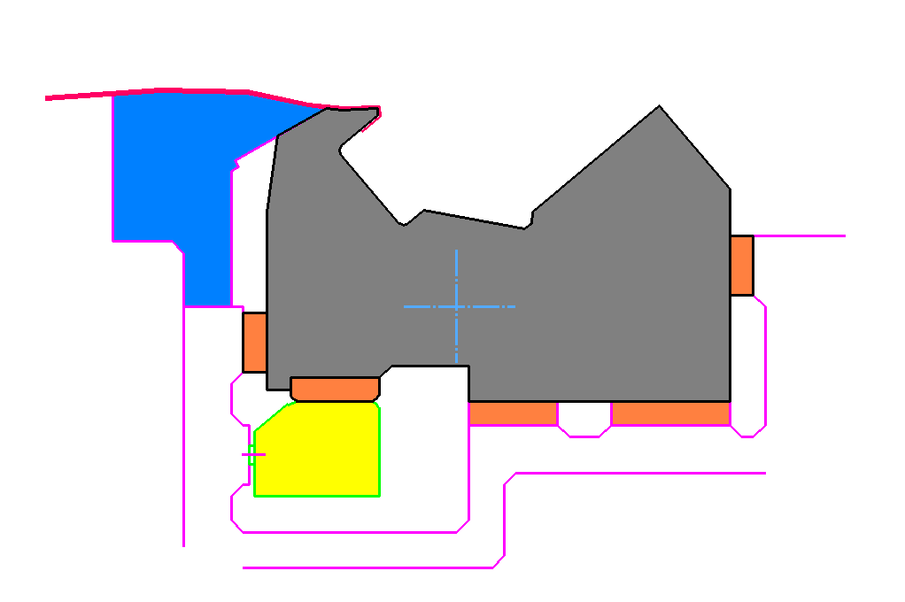
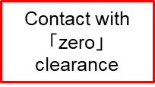
1.1 Features of Swing Cam①
1．Features of Swing Cam
（１）Compact and simple machining
（２）Improvement of product quality by high stiffness
Contact with 「zero」clearance
Integrated structure
It is all machining on flat surface of press die.
It is possible to make a forming far from the pivot position.
It is possible to design the die with a compact.
It is easy for maintenance because stopper plate does not slide.
Rotating pivot
“Slide Block”
It is possible to be adjusted with shims.
（３）Extreme improvement in maintainability

Slide 4
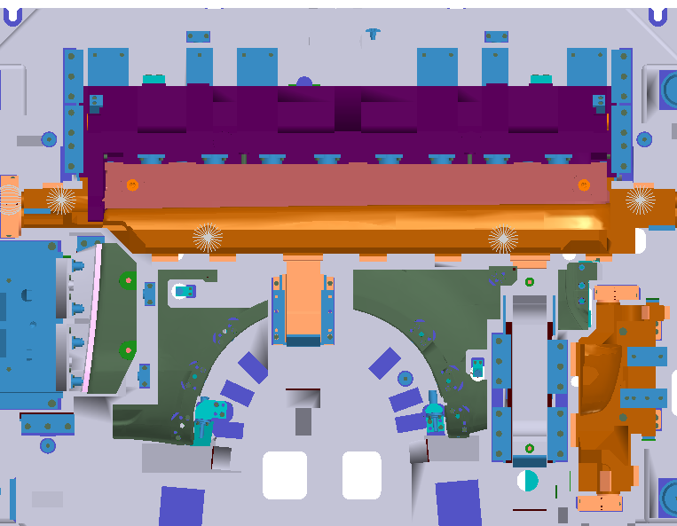
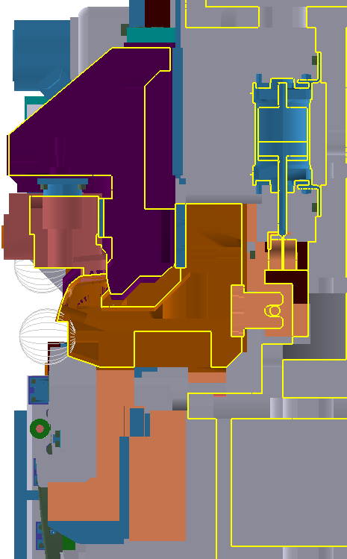
1.2 Features of Swing Cam②
1．Features of Swing Cam
B
It is all machining on flat surface of press die.
Make the die with a compact
SEC B-B
B
Integrated structure
High stiffness
Low cost
With back-up
No sliding portion

Slide 5
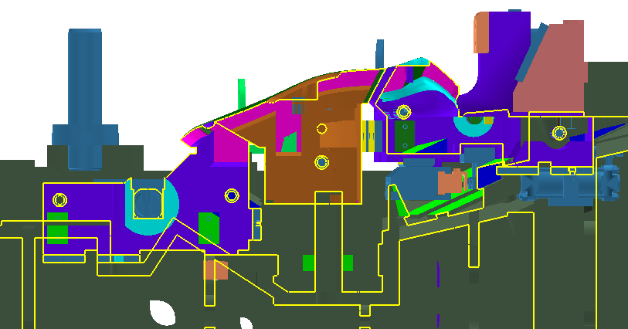
1.3 Comparison with both Swing Cam and holder side
1．Features of Swing Cam
In case of using Swing Cam,
it is all possible to machine of flat surface on the press die.

Slide 6

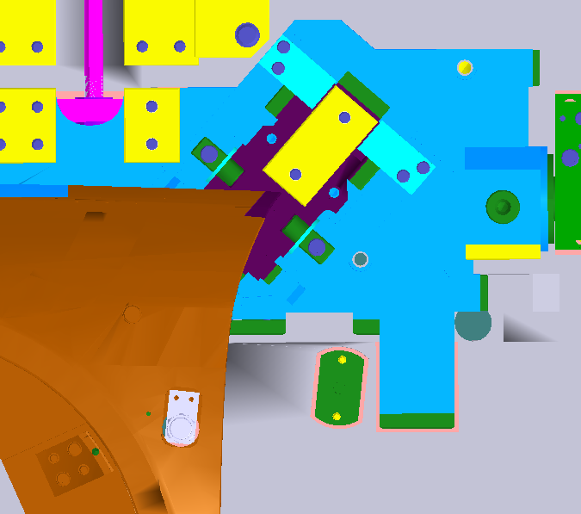
1.4 It is possible to reduce the process with combined machining and continuous machining by Swing Cams Systems
1．Features of Swing Cam
6/41
（４）-1 FENDER
（４）-2 DOOR
Positive Follower System
（Half Mount Cam system）
Large swing direction
Small swing direction
Cam unit for forming
Cam unit for piercing

Slide 7
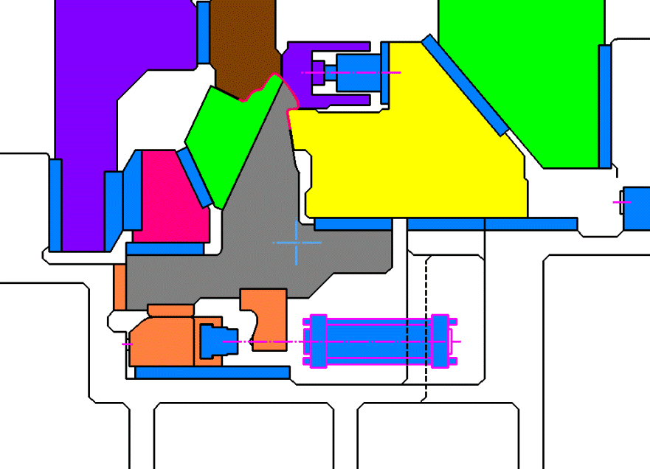
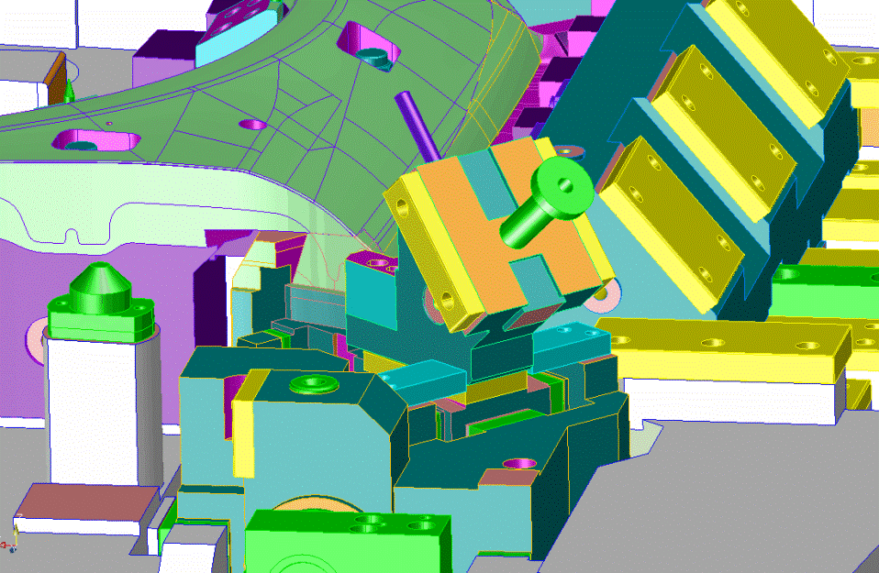
1．Features of Swing Cam
7/41
1.5 Various Swing Cam Systems
①Drop Swing System
②Swing on Swing System
By both the large Swing Cam and small Swing Cam
Ex)For BSO, Front Piller etc.

Slide 8
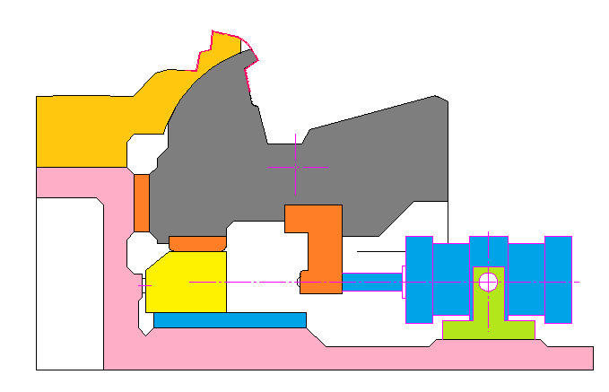
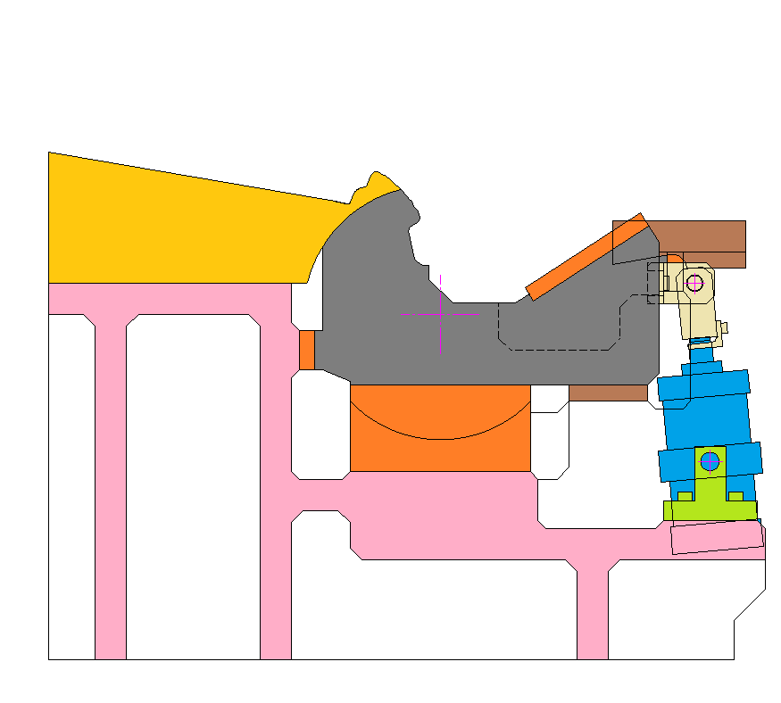
1．Features of Swing Cam
③Arc Swing System
④Half Mount Cam System
It is 「zero」clearance at the setting time, but it makes some clearance on the rotating time, which is our Your Business Co.,Ltd. has a patent of the systems.

Slide 9
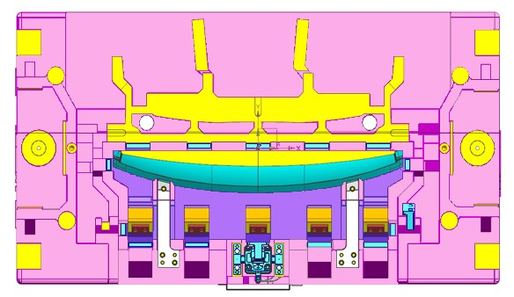
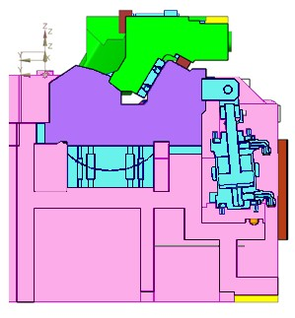
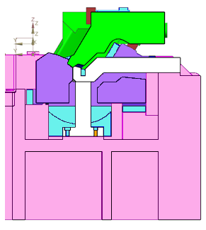
2.1 Features of Half Mount Cam①
2．Features of Half Mount Cam
A→
B→
A→
B→
It is possible to set a position of rotating pivot on the inside of the panel or on the forming side of the panel.
High Strength bronze with GR
Pre-hardened steel
Contact on Round surface.
A-A
All flat machining of surface
It is easy to be adjusted.
B-B

Slide 10
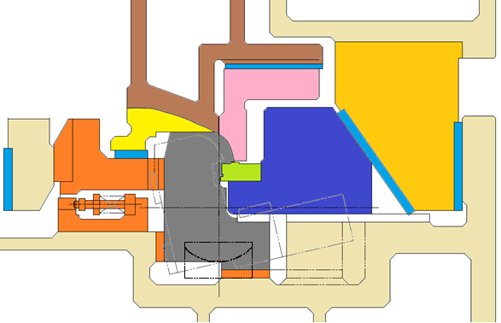
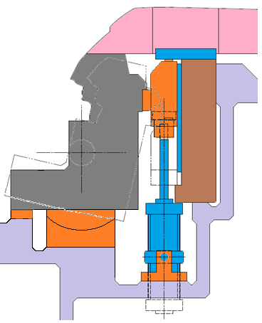
It is possible to make a structure of the die mounted cam system by a mechanism of the positive return followers.
2．Features of Half Mount Cam
2.2 Features of Half Mount Cam②
It is possible to make a structure of larger Swing Cams.(It is available for 4m or more.)
Half mount system is available.

Slide 11
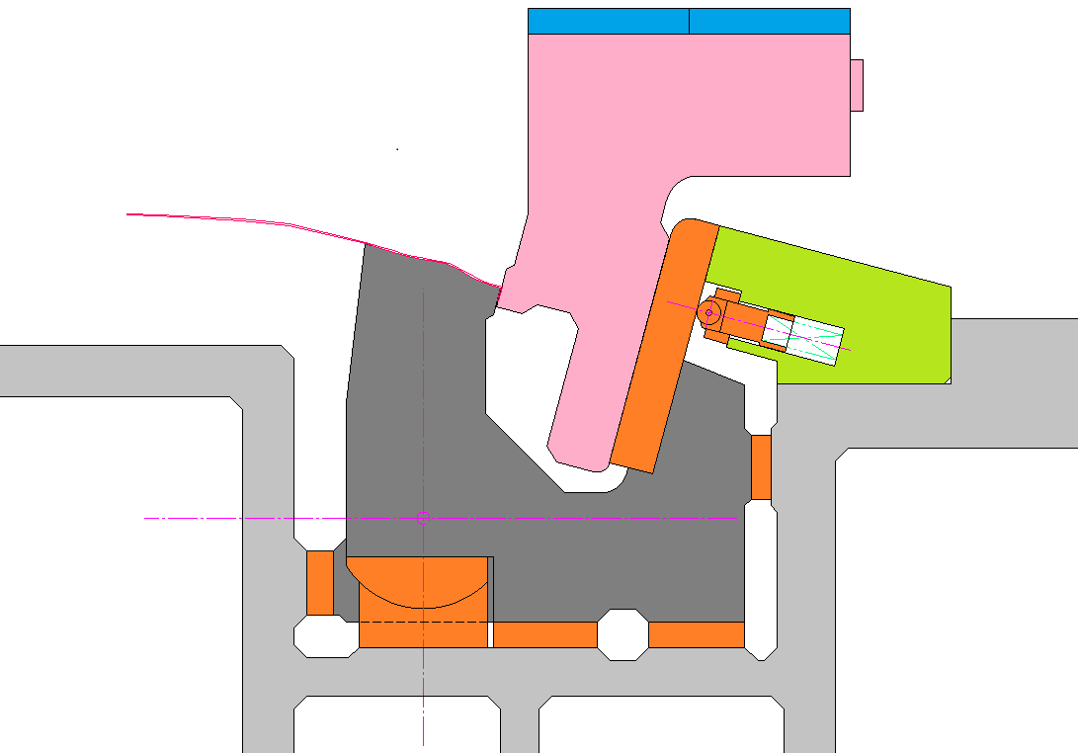
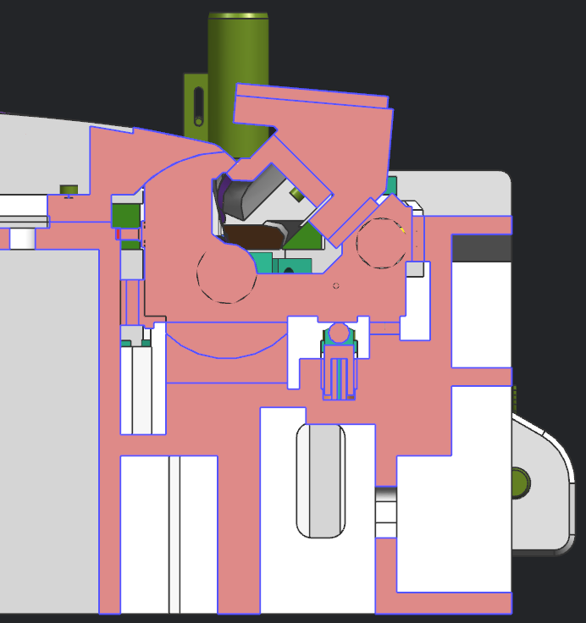
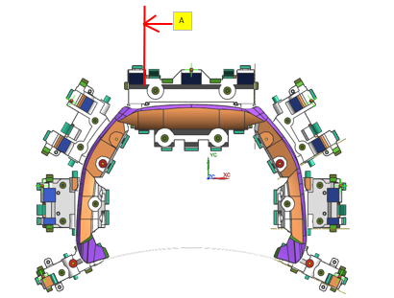
2.3 Air cylinderless mechanism
2．Features of Half Mount Cam
Half Mount Cam
SEC-A
Lift pin
For example, it is forming structure of narrow area.

Slide 12
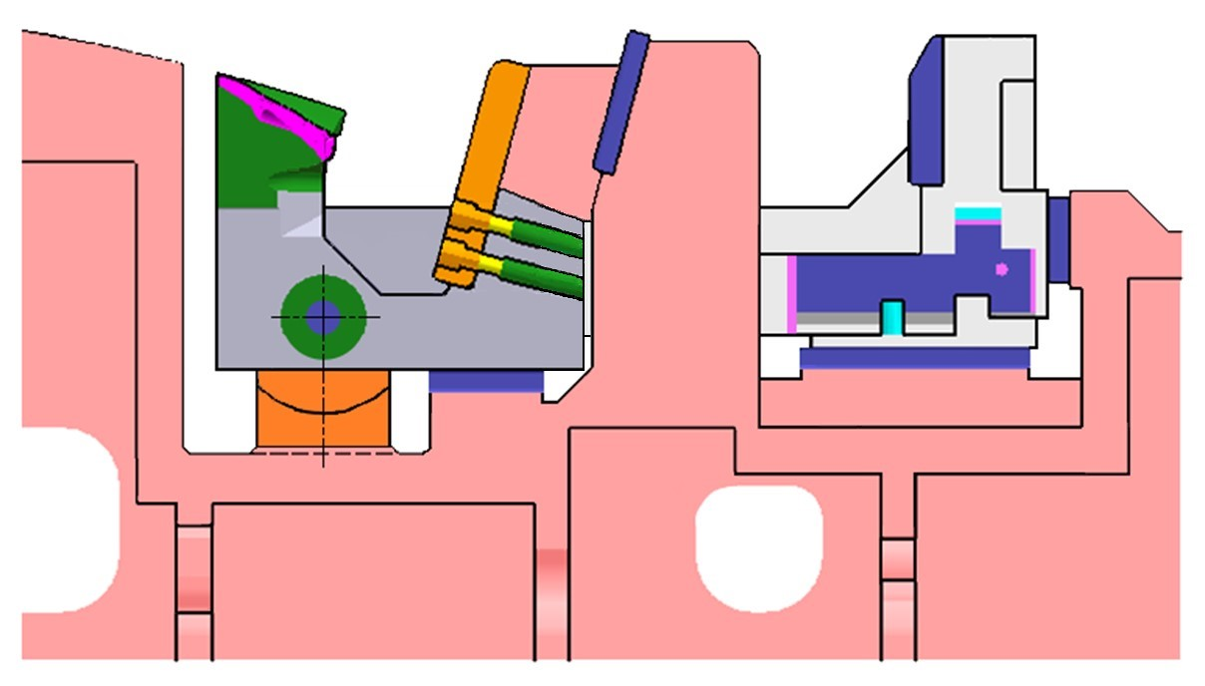
3.1 Making a compact of press die
3．Making a compact of press die
12/41
In case of using Double Cam
In case of using Swing Cam

Slide 13
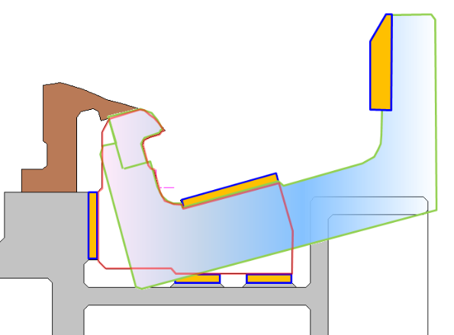
3.2 Comparison with Double Cam①
3．Making a compact of press die
It causes a low productivity.
Double Cam
Other steel materials for double cam
（problem on cost and strength）
１、There is many sliding surfaces.
→It is necessary to be adjusted for increasing a time.
２、It makes larger structure of press die.
３、It is difficult to machine.
４、It is necessary to be devided of punch.
５、It is not improved of productivity.
６、There is weak problem on the strength.
「zero」clearance
The edge of the Swing Die
１、Almost no sliding surface. → Saving for adjustable time.
It is possible to be improved to
a compact structure of press die.
２、Compact design.
３、It is possible to be machined with all horizontal and vertical direction.
４、It is possible to be manufactured the integrated punch.

Slide 14

3.3 Comparison with Double Cam②
3．Making a compact of press die
The Double Cams structure makes the die size become larger.

Slide 15
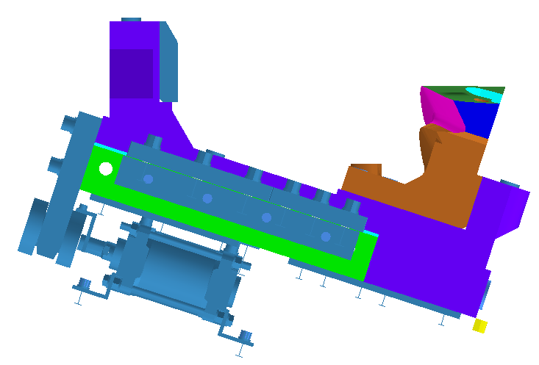

3.4 Comparison with Double Cam③
3．Making a compact of press die
Since it is necessary to devide punch,
the cost of die will increase.
According to devided punch, it decreases the strength of punch.
Since it has to lift a heavy cam driver,
the production speed will slow down

Slide 16
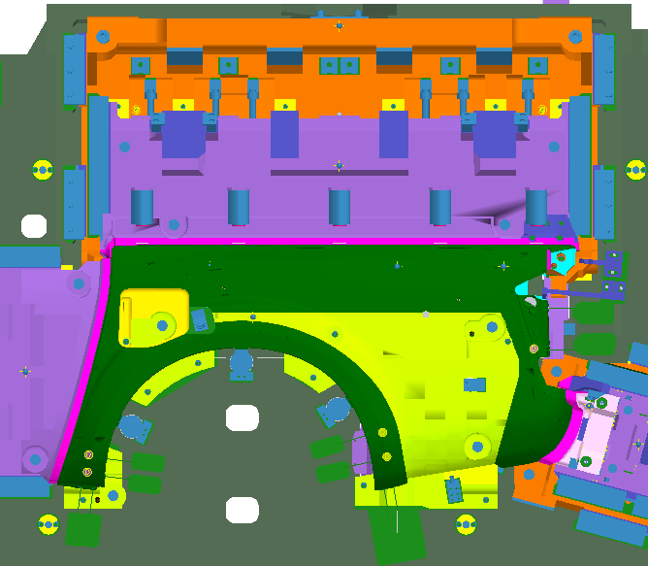
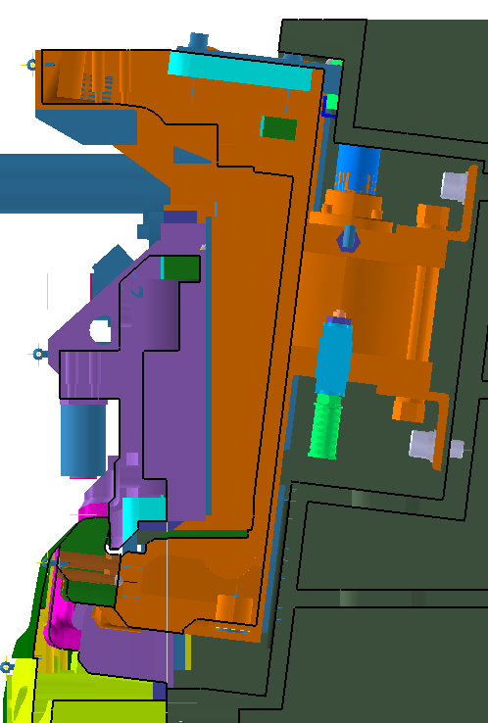
3.5 Comparison with Double Cam④
3．Making a compact of press die
Lifting up
Double size of the panel
A
SEC A-A
A
Devided structure
Weak strength
High cost
No back-up
Many sliding area

Slide 17
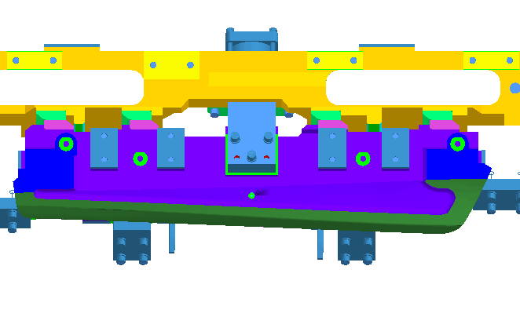
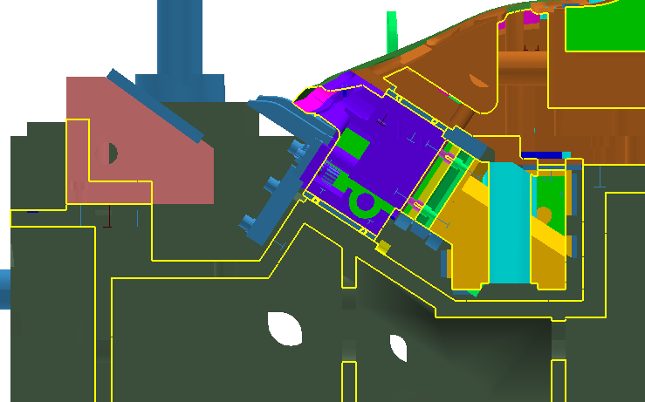
3.6 Comparison with a Counter Cam, a Double Cam and a Large Cam
3．Making a compact of press die
It is necessary to machine the main body side with 5 axes machine.
It is increasing the cost of die because of using a Large Cam unit.
Since there are many sliding surfaces, it is not easy for maintenance.

Slide 18
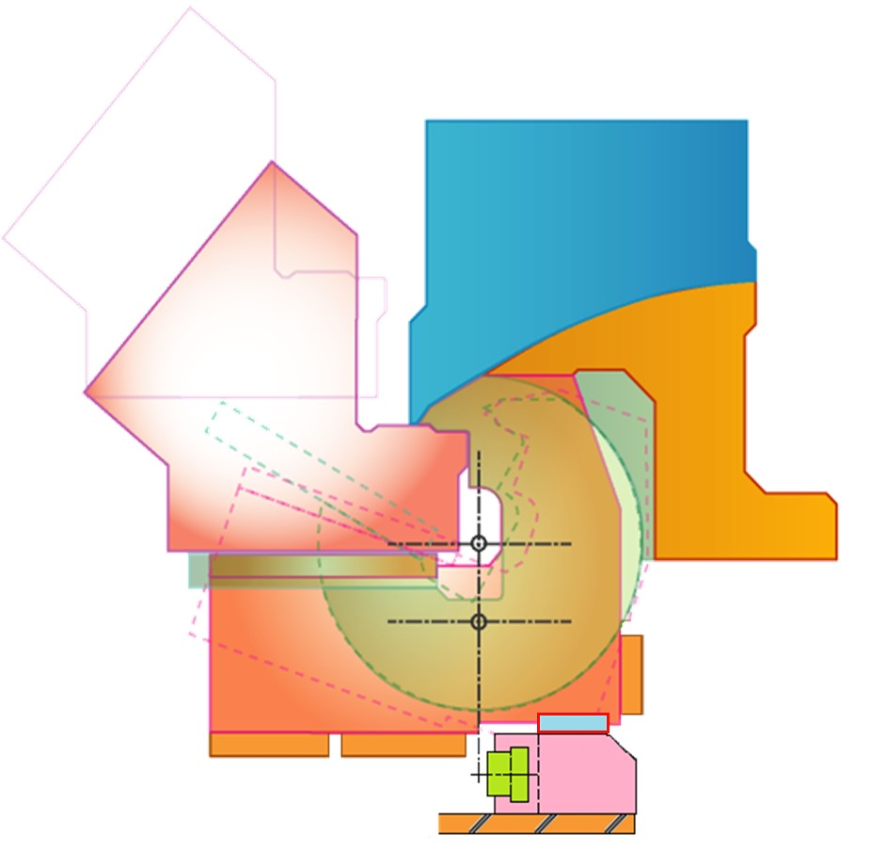
3.7 Comparison with Rotary Cam
3．Making a compact of press die
The Rotary Cam is distorted with
cladding by welding & F/H and does not move.
The Rotary Cams may wear out in production of
around 100,000 units.
Since the Swing Cam keeps zero clearance, there is not weared.
It is possible to make a cladding by welding and F/H.
All around clearance
0.02mm
Height at the time of removal
Rotary Cam
Pivot position of
Rotary Cam
Swing Cam
Forming Load
Since it is unable to be adjusted of
the clearance for Rotary Cam,
it is necessary to work cladding by welding or remake.
Pivot position of
Swing Cam
Contact with 「zero」clearance
It is very easy to be adjusted with shim up for Swing Cam.
Setting of stopper mechanism
avoiding of rotating.
Contact with 「zero」clearance

Slide 19
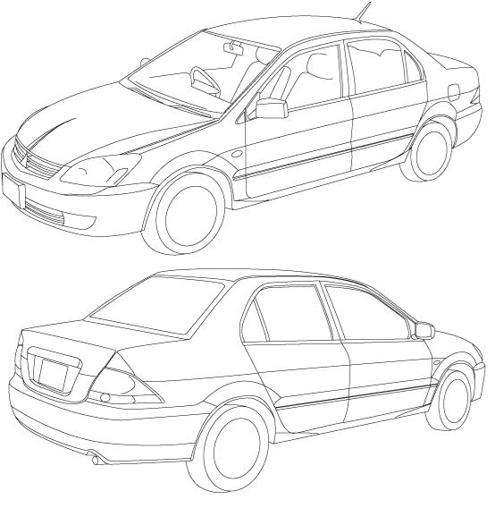
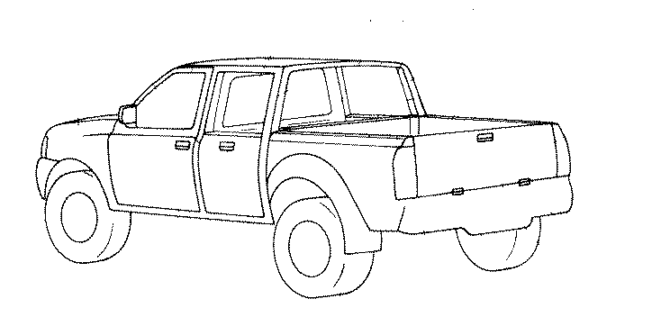
DOOR OUTER
4．Design Example
4.Design Example
HOOD OUTER
LIFT GATE OUTER
TRUNK LID OUTER
FR FENDER OUTER
BODY SIDE OUTER
ROOF
BOX SIDE OUTER

Slide 20
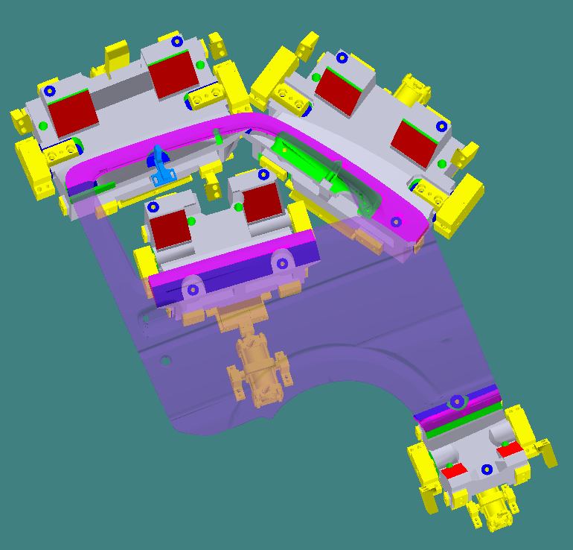
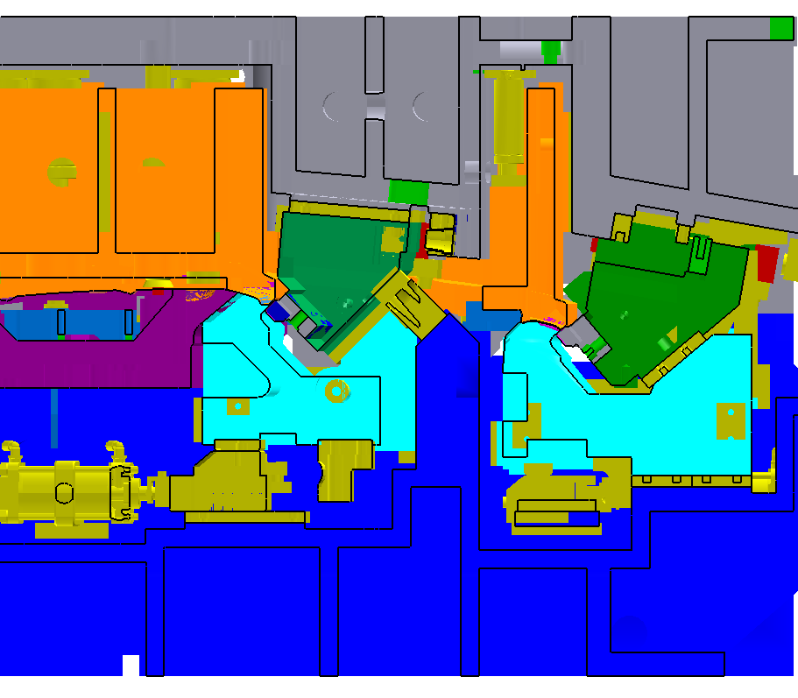
4．Design Example
4.1 DOOR OUTER（Ex.1）
Whole Door
The process can be improved by both forming the sash and belt line
at the same time(3 operations).

Slide 21
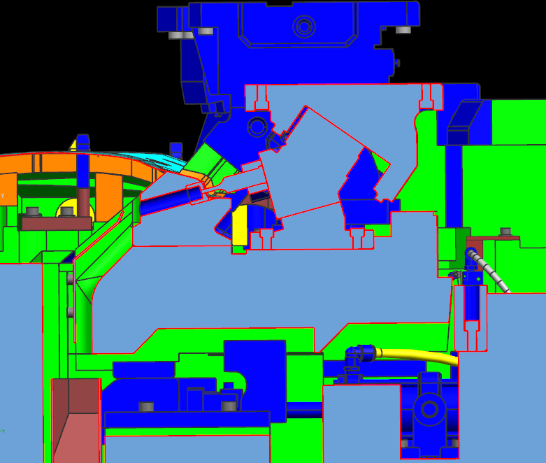
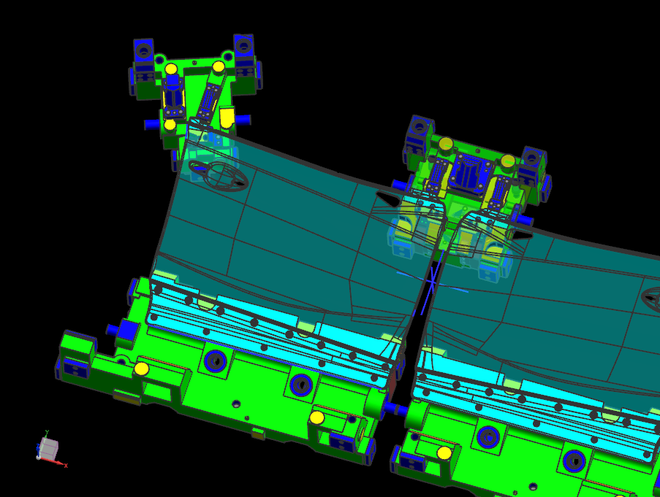
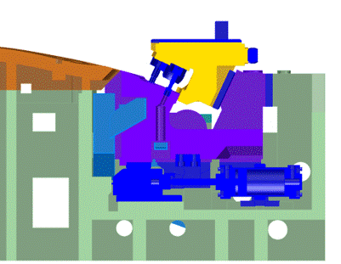
4．Design Example
4.1 DOOR OUTER（Ex.2）
Achieves to 3 operations by processing both cam piercing
and cam flange at the same time with a swing cam.
SEC-A
[Flange＆Piercing]
[Flange＆Piercing]
A
SEC-B
B
[Flange＆Piercing]

Slide 22
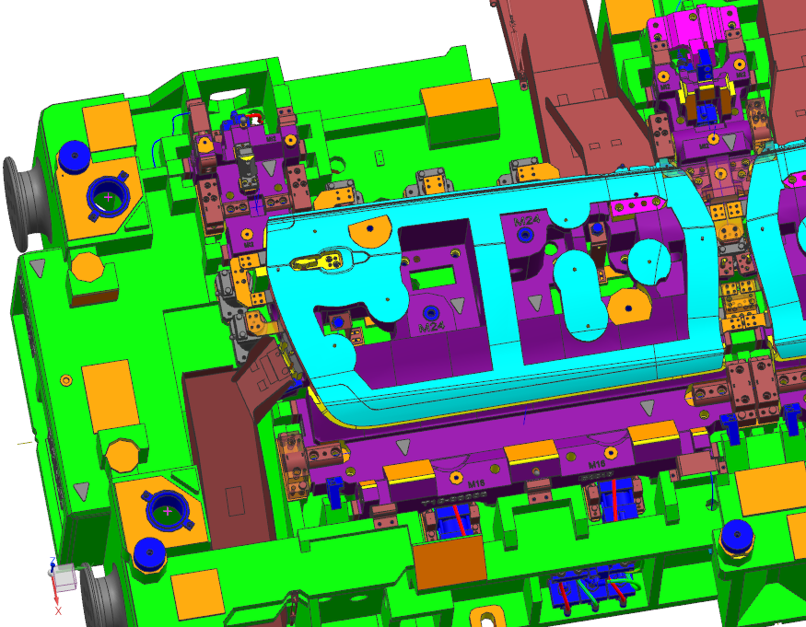
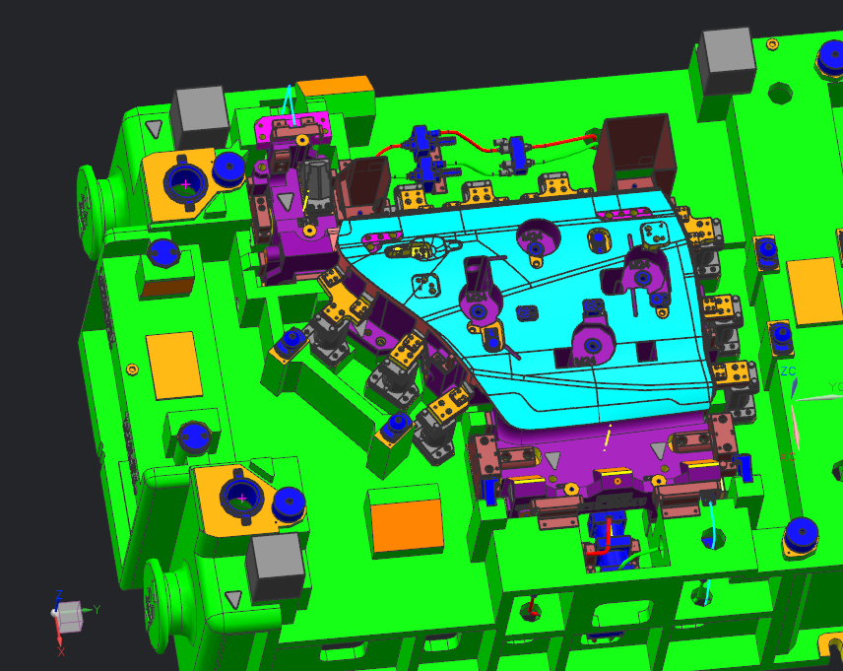
4．Design Example
4.1 DOOR OUTER（Ex.3）
[Cam flange＆Cam piercing]
[Cam flange]

Slide 23
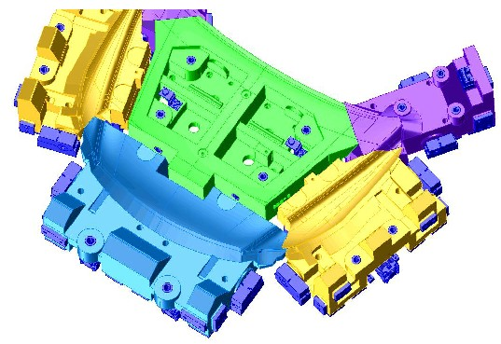
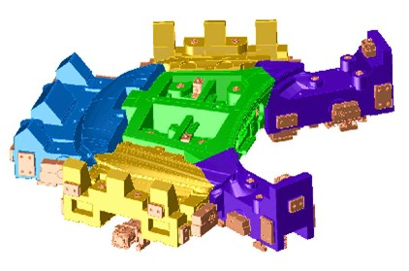
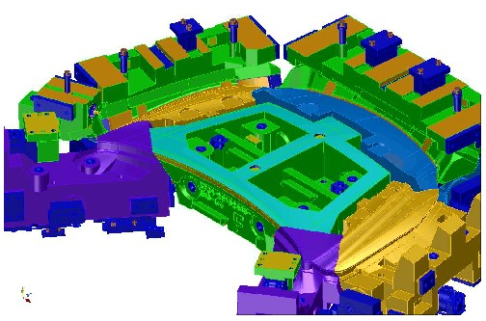
4．Design Example
4.2 HOOD OUTER（Ex.1）
Swing Cams:5-combinations
Forming once by Swing Cam
(Improvement of quality, process and no necessary to make the structure of flange lifters.)

Slide 24
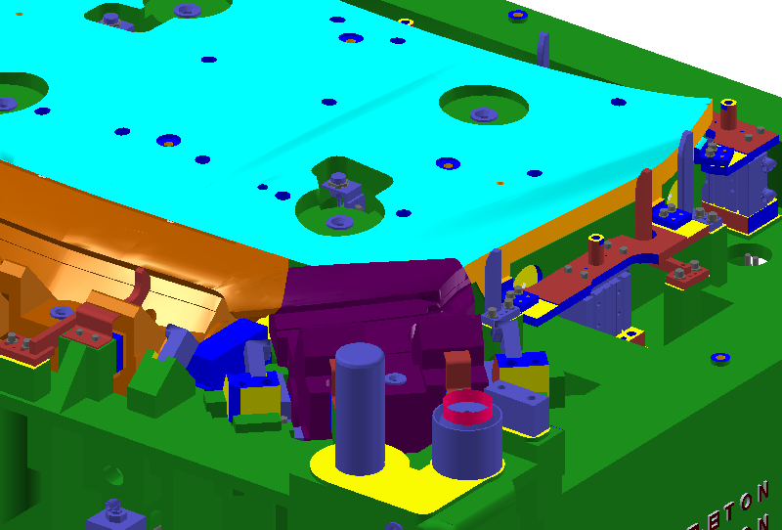

4．Design Example
4.2 HOOD OUTER（Ex2、Ex3）
Swing Cams:3-combinations

Slide 25
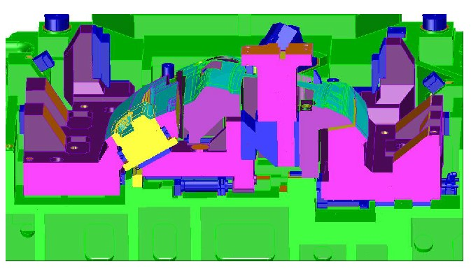
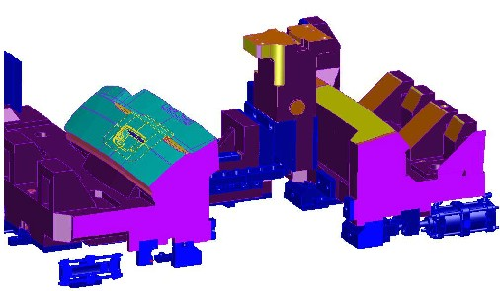
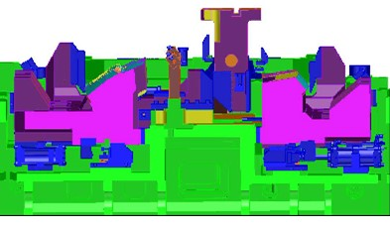
4．Design Example
4.3 LIFT GATE OUTER

Slide 26
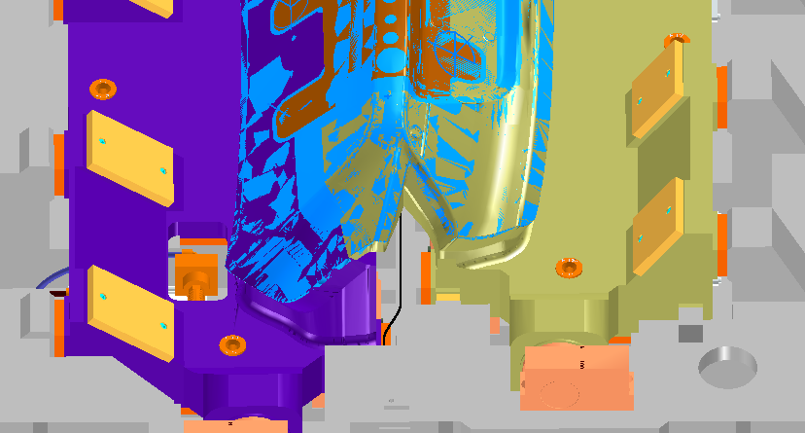
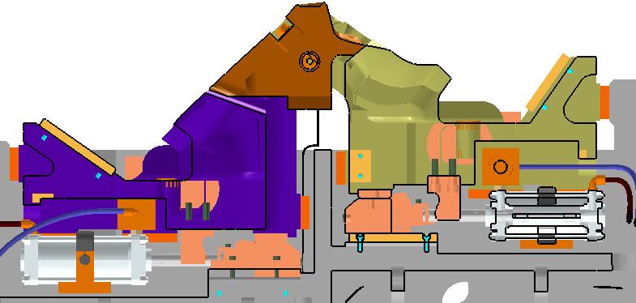
4．Design Example
4.4
TRUNK LID OUTER

Slide 27
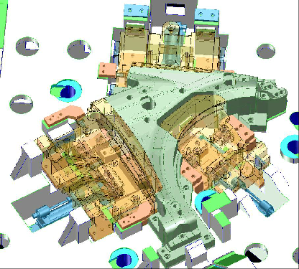
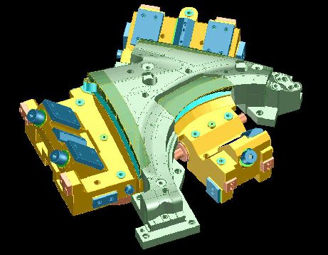
4．Design Example
4.5 FR FENDER（Ex.1）
Fender with 3-operations

Slide 28
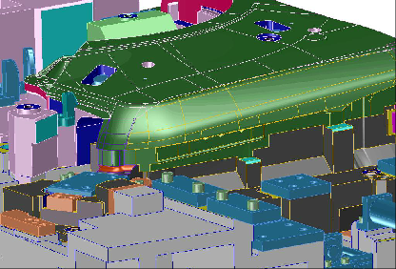
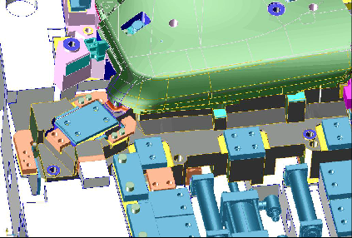
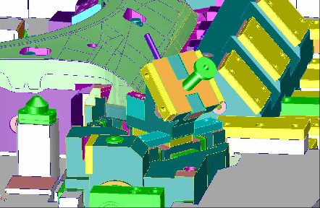
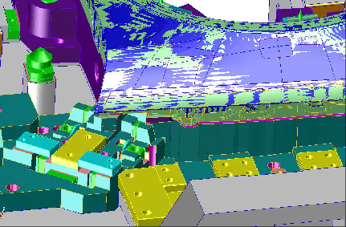
4．Design Example
4.5 FR FENDER（Ex.2）
Swing on Swing Cams System（Large Swing Cam and Small Swing Cam）

Slide 29




It is possible to be assembled the Swing Cam or Half Mount Cam as a module of unit.
4．Design Example
4.5 FR FENDER（Ex.3） Swing Module(Unit)
It is all machining of the assembled surface on the main body,
then it is possible to put Swing Cam on it.
Unit for door side
Unit for wheel arch side

Slide 30



4．Design Example
4.6 BODY SIDE OUTER(Ex.1)
（Drop Swing Cam）

Slide 31



4．Design Example
4.6 BODY SIDE OUTER(Ex.2)
Arc Swing Cam

Slide 32




4．Design Example
4.7 ROOF（Ex.1）
3-operations

Slide 33



4．Design Example
4.7 ROOF（Ex.2）
A
A
Forming Sunroof and beading
Hatchback type
SEC A-A

Slide 34




4．Design Example
4.8 BOX SIDE OUTER
Actual results of maximum length 4ｍ

Slide 35



5.1 Assembling of the Swing Cam
5．Assembling of the Swing Cam
It is adjusted to be flat to the bottom surface of Swing Cam.
Contact with 「zero」clearance
Contact with 「zero」clearance
It is all adjusted to be flat to the surface of Swing Cam on the area.
It is all machining the shape of a flat Swing Cam on the flat surface.

Slide 36






5.2 Assembling of the Swing Cam “Easy 3 Steps”
5．Assembling of the Swing Cam
STEP1
After adjusting the clearance, it should be checked the operation of the cylinder.
Side clearance
Clearance 0ｍｍ
0
STEP3
STEP２
Clearance 0.2~0.15
Shape machining
0
Finally
0
Clearance 0~0.05
Target value 0.025
Since the Swing Cam is simple structure compared with the other mechanisms, it should be adjusted without a fail before starting of machining shape.

Slide 37
6.1 Cost Comparison
6．Comparison with other mechanisms

Slide 38
6.2 Mechanisms Comparison
6．Comparison with other mechanisms
 | Swing Cam Half Mount Cam | Double Cam | Large Cam | Rotary Cam
Total Cost | ○ | △ | × | ×
Die Size | ○ | × | △ | ○
Cam Strength | ○ | × | △ | -
Shortening Process | ○ | × | △ | △
Manufacturing | ○ | △ | × | ××
Maintenance | ○ | △ | × | ×
Product quality | ○ | × | ○ | -
Awareness | △ | ○ | ○ | ○

Slide 39


7.1 Maintenance
7.Maintenance
Check the loosening bolt
Check the loosening bolt
Check the loosening bolt
Do not apply the grease on the contact of 「zero」clearance for the cleaning
１、Cleaning
２、Wipe off the grease on the contact of 「zero」clearance
３、Check the loosening bolt
Do not apply the grease on the contact of 「zero」clearance for the cleaning

Slide 40


8. Supporting system
Creating a 3D plan drawing of Swing Cam
8．Supporting system
File format is dwg.dxf
Solid model of each devided Swing Cam
Data format is STEP, UG, CATIA, etc.
In addition, it is available to convert
to the requested format.

Slide 41


Please contact Your Business Co., Ltd. when you will adopt and learn about Swing Cam.
Swing Cam (registered trademark) is a patented product of Your Business Co., Ltd., and we have obtained and applied for various patents including peripheral patents.
※This content is all effective on dated July 2021 so far.
According to further improvement in product, the specification is subject to change without notice.
Your Business Co.,Ltd.
1466-4 Hino, Hino-city, Tokyo, Japan
191-0012
TEL: +81-42-585-1711
FAX: +81-42-585-1721
http://www.yourb.co.jp/

